Slide 1
Standing Apart: In a world of AI, ATS, ghosting, and steep role requirements how to stand apart.
By: Brad Voris

Slide 2
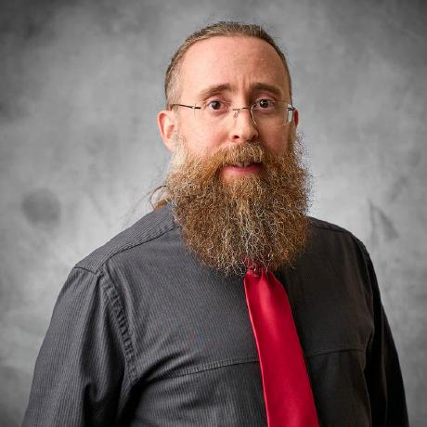
Brad Voris, Security Guy
Security Professional (Engineer/Manager/Architect)
26+ years of experience IT/IS/CS
Undergrad in Cybersecurity @ Wilmington University
Certifications: CISSP, CISM, CCSP, CCSK, TAISE, Network+, MTA, MCP, etc.
Co-Author 2 books: Intrusion Detection Guide and Essentials of Cybersecurity for Peerlyst
Cloud Security Alliance Zero Trust Training Contributor
Peer Reviewer, Editor and Collaborator on numerous articles, books and whitepapers…
NOT AN EXPERT
www.VictimOfTechnology.com / www.github.com/bvoris

Slide 3
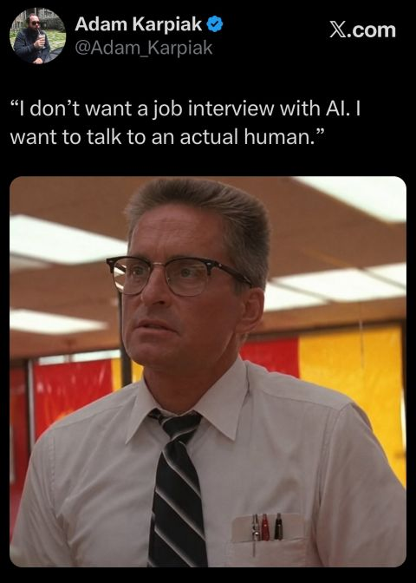

AI: What has AI done for recruiting?
AI is still in its infant stages for recruiting:
Sourcing candidates
Job Descriptions
Resume Screening (w/alignment to ATS)
Interview Support
Data Analytics
AI cannot determine your cultural fit, leadership potential, integrity, creativity or adaptability.
www.VictimOfTechnology.com / www.github.com/bvoris

Slide 4

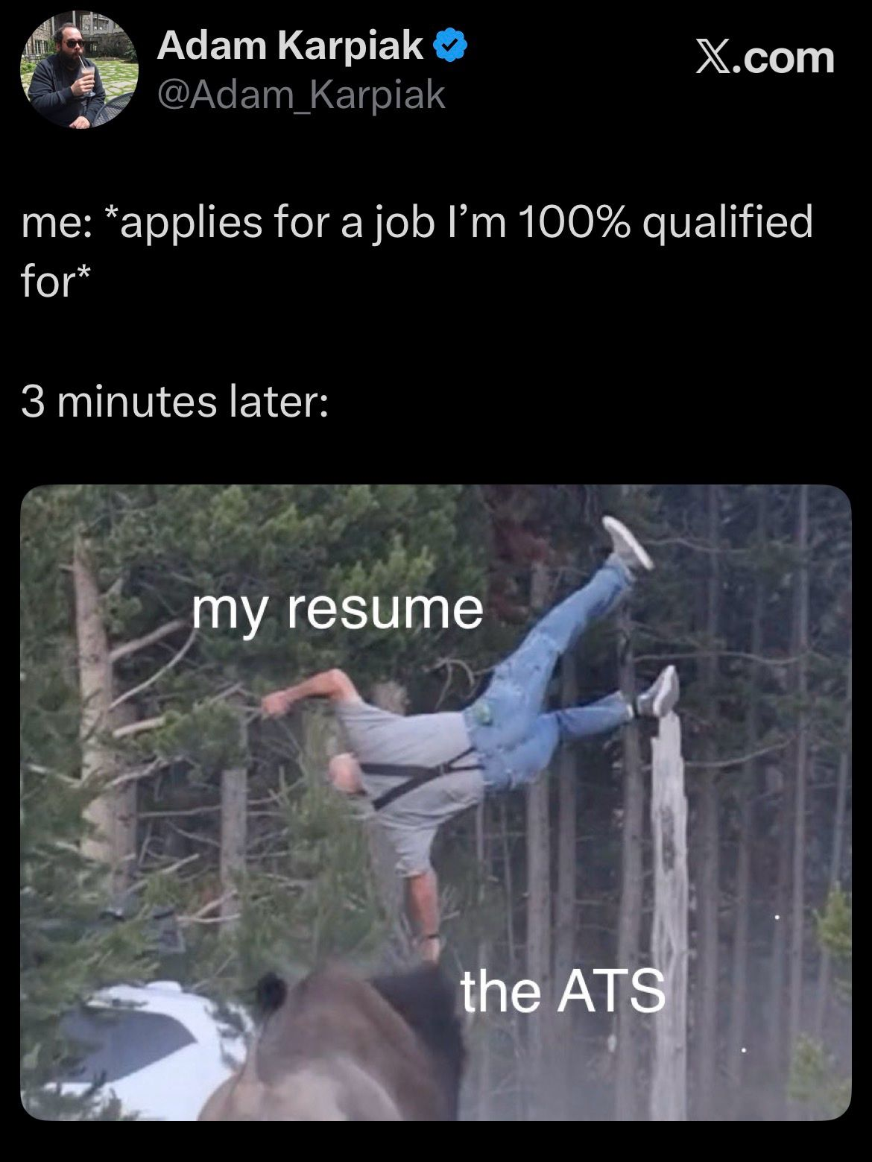
ATS: Applicant Tracking Systems
ATS primarily look for key indicators that align to the role you are applying for with in your resume:
Keywords
Job Titles
Skills
Certifications
Experience
ATS isn’t deterministic, its allowing recruiters to deal with an overwhelming number of resumes that current systems cannot accommodate.
www.VictimOfTechnology.com / www.github.com/bvoris

Slide 5
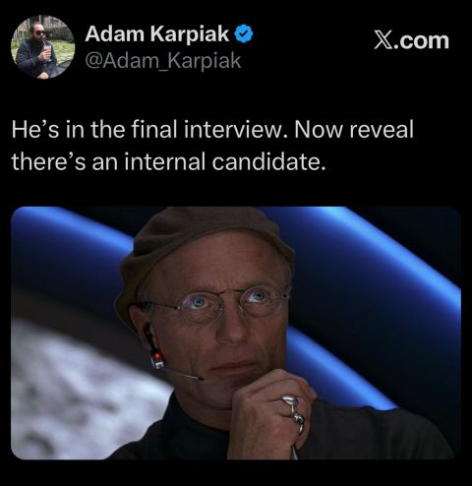

This is what recruiters see…
Doesn’t meet the educational requirements…
Doesn’t meet the skill requirements…
Doesn’t meet the certification requirements…
Doesn’t meet the experience requirements…
Poorly formatted resume…
Misspellings in resume…
Multiple short stays at roles for less than one year…
Gaps on your resume…
Incomplete job application…
www.VictimOfTechnology.com / www.github.com/bvoris

Slide 6






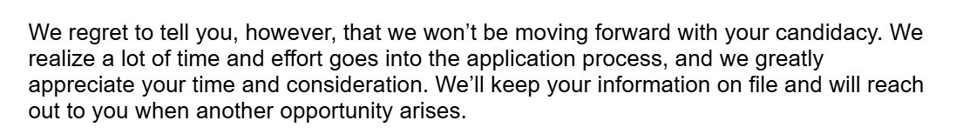

What you and I see…
www.VictimOfTechnology.com / www.github.com/bvoris

Slide 7
What will help… CAPABILITY
  KNOW WHAT YOU WANT TO DO
  SHOW what you know and what you are capable of…
  Create a portfolio of your work: Technical writing, Github projects, diagrams, educational content, LinkedIn articles, etc.
  Documented Labs
  Share your content with other people…
www.VictimOfTechnology.com / www.github.com/bvoris

Slide 8
What will help… ENGAGEMENT
  Get a MENTOR
  Networking not just LinkedIn but meeting people at meetups, conferences (like CYBR.SEC.CON, bSides, HAHA, Etc.)
  Connecting with hiring managers, HR recruiters, and reaching out for roles you want
  Engaging with people and content on LinkedIn and other platforms (Post something Weekly, because visibility is crucial)
  Get help with your resume, doesn’t mean you have to pay but work with hiring managers to determine what they are looking for
  Referrals have a better success rate then blind applications
www.VictimOfTechnology.com / www.github.com/bvoris

Slide 9
What will help… DIVERSIFY
  The EASY APPLY button isn’t going to save you
  Spread resume across multiple platforms
  Utilize 3rd party recruiters and recruiting systems
  Contract and contract to hire roles will likely get your foot in the door
www.VictimOfTechnology.com / www.github.com/bvoris

Slide 10
What will help… EDUCATE
  Focus on educating yourself
    Obtain certifications that are relevant to what you want to do
  Skill yourself up with labs and online classes
  Align your skills and resume to roles that you are better suited for
www.VictimOfTechnology.com / www.github.com/bvoris

Slide 11
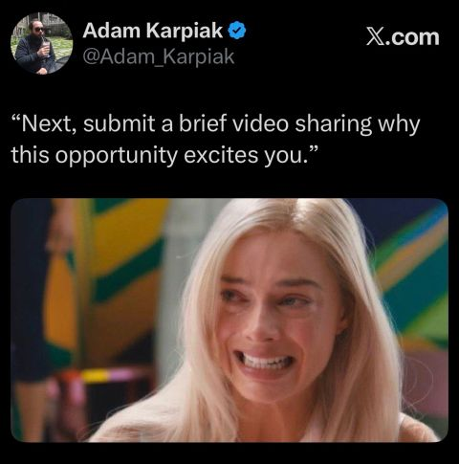
What employers want today…
  Experience: 1-3 years
  Education: Bachelor’s Degree (Information/Cybersecurity Related)
  Skills: Soft Skills, Endpoint Security, Intrusion Detection, Governance
  Certification: Security+, CySa+, CISA, CISSP, GCIH, GSEC
  Leadership
  Tenacity
  Determination
  Agility
www.VictimOfTechnology.com / www.github.com/bvoris

Slide 12
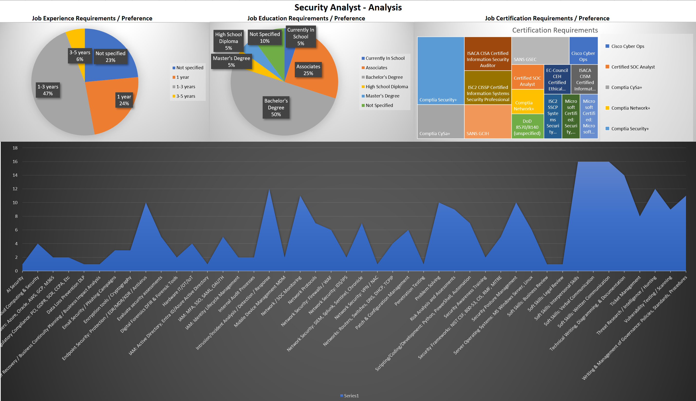
2026 Security Analyst Research
www.VictimOfTechnology.com / www.github.com/bvoris

Slide 13
A letter to employers…
Thank you for the time and effort that you and your organization invested throughout the interview process. I truly appreciate the opportunity to meet with the team and participate in the numerous interviews, the one-hour presentation, and screening discussions.
After careful consideration, I have decided to move forward with another organization whose opportunity aligns more closely with my current career goals and personal needs.
I understand how competitive your selection process is, and with that in mind, I regret to inform you that your organization was not selected. While this may come as a surprise, I hope you can appreciate the irony after the thorough evaluation process we both experienced.
I will certainly keep your organization in mind for future opportunities and would not hesitate to recommend you to colleagues should the right situation arise.
Thank you again for your time, professionalism, and consideration. I wish you and your team continued success and the very best in finding the right candidate for the role.
www.VictimOfTechnology.com / www.github.com/bvoris

Slide 14

www.VictimOfTechnology.com / www.github.com/bvoris

